Slide 1
Transmission Media & Optical Communication
Course Code: COE 3201
Course Title: Data Communication
Dept. of Computer Engineering
Faculty of Engineering
Lecture No: | 11 | Week No: | 12 | Semester:
Lecturer:

Slide 2
Lecture Outline
The first section introduces the transmission media and defines its position in the Internet model. It shows that we can classify transmission media into two broad categories: guided and unguided media.
The second section discusses guided media. The first part describes twisted-pair cables and their characteristics and applications. The second part describes coaxial cables and their characteristics and applications
The third section discusses unguided media. The first part describes radio waves and their characteristics and applications. The second part describes microwaves and their characteristics and applications.

Slide 3

Transmission Medium
Transmission media are actually located below the physical layer and are directly controlled by the physical layer. We could say that transmission media belong to layer zero. Figure 7.1 shows the position of transmission media in relation to the physical layer.
Figure 7.1: Transmission media and physical layer

Slide 4
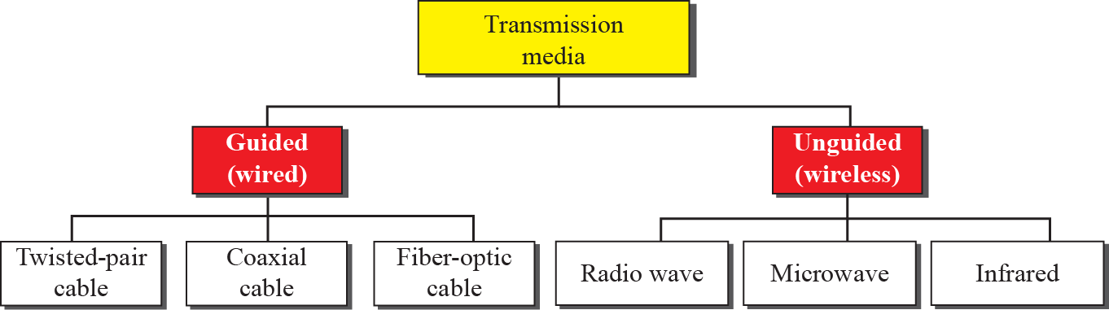
Transmission media
Figure 7.2: Classes of transmission media

Slide 5
GUIDED MEDIA
Guided media, which are those that provide a conduit from one device to another, include twisted-pair cable, coaxial cable, and fiber-optic cable. A signal traveling along any of these media is directed and contained by the physical limits of the medium.
A twisted pair consists of two conductors (normally copper), each with its own plastic insulation, twisted together, as shown in Figure 7.3.
One of the wires is used to carry signals to the receiver, and the other is used only as a ground reference. The receiver uses the difference between the two.
In addition to the signal sent by the sender on one of the wires, interference (noise) and crosstalk may affect both wires and create unwanted signals.

Slide 6
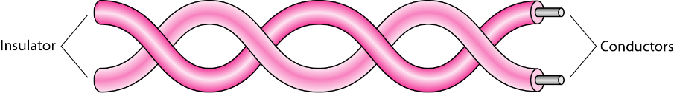
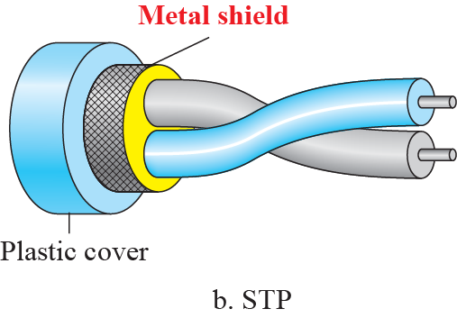
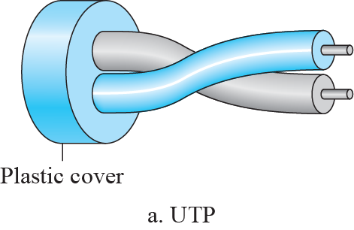
Twisted-Pair Cable
Figure 7.3: Twisted-pair cable
Figure 7.4: UTP and STP cables

Slide 7
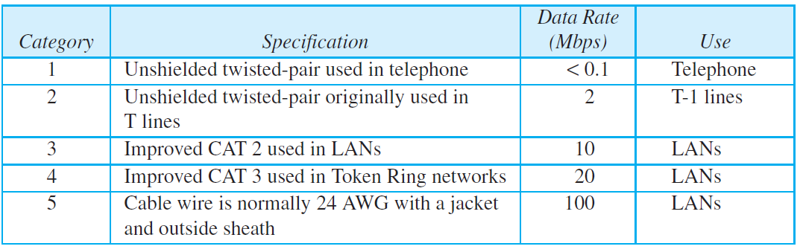
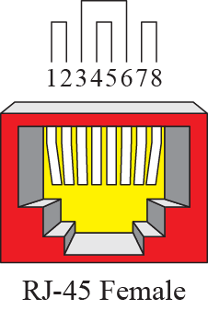
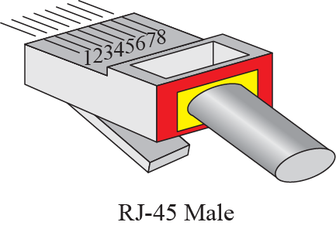
Twisted-Pair Cable
Table 7.1: Categories of unshielded twisted-pair cables
Figure 7.5: UTP Connectors

Slide 8
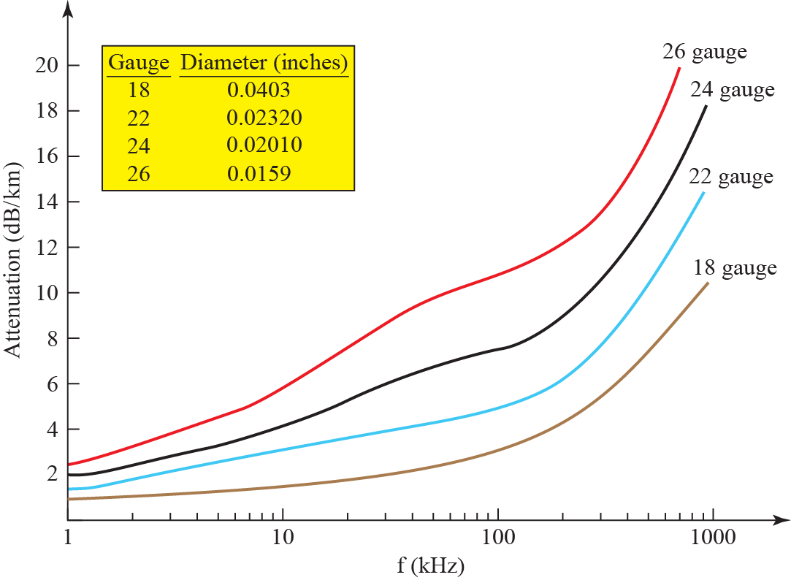
Twisted-Pair Cable
Figure 7.6: UTP Performance

Slide 9
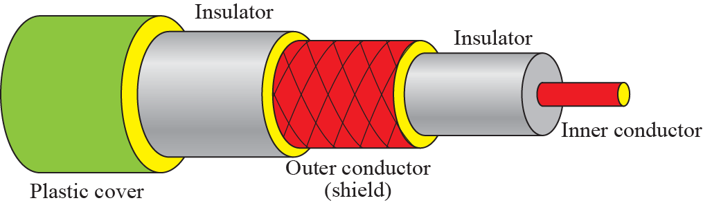
Coaxial Cable
Coaxial cable (or coax) carries signals of higher frequency ranges than those in twisted pair cable, in part because the two media are constructed quite differently. Instead of having two wires, coax has a central core conductor of solid or stranded wire (usually copper) enclosed in an insulating sheath, which is, in turn, encased in an outer conductor of metal foil, braid, or a combination of the two. The outer metallic wrapping serves both as a shield against noise and as the second conductor, which completes the circuit.
Figure 7.7: Coaxial cable

Slide 10
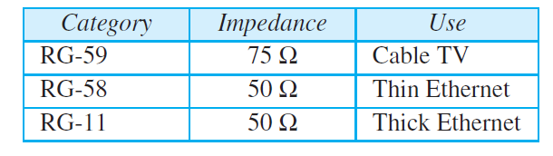
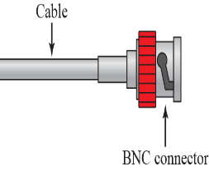
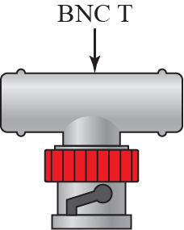
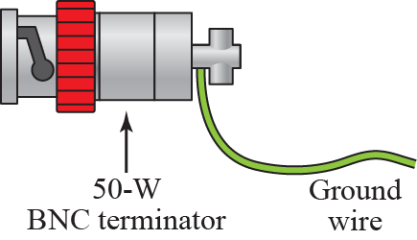
Coaxial Cable
Table 7.2: Categories of coaxial cables
Figure 7.8: BNC connectors

Slide 11
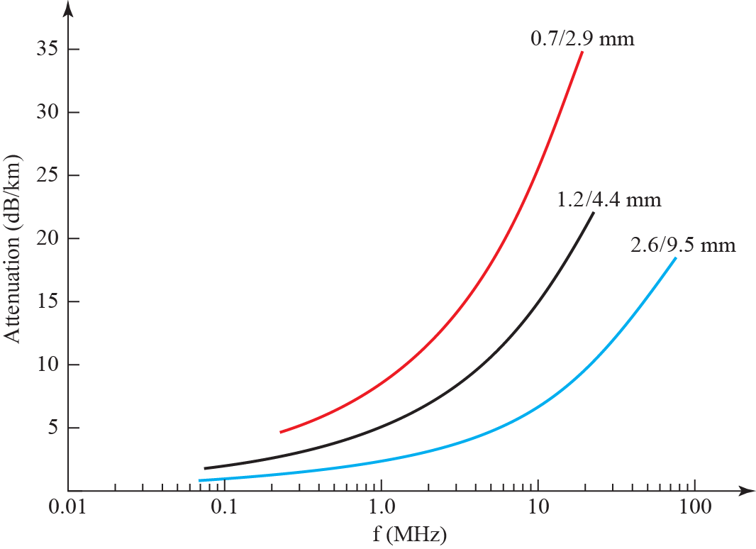
Coaxial Cable
Figure 7.9: Coaxial cable performance

Slide 12
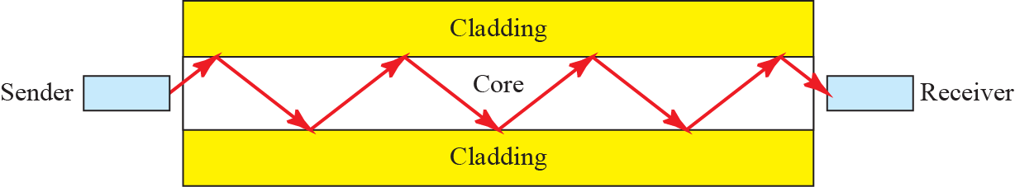
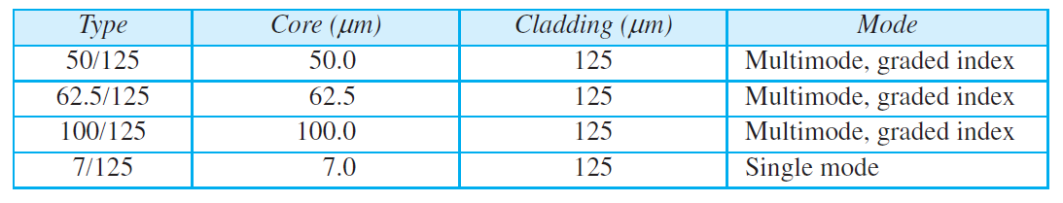
Fiber-Optic Cable
A fiber-optic cable is made of glass or plastic and transmits signals in the form of light. To understand optical fiber, we first need to explore several aspects of the nature of light.
Figure 7.11: Optical fiber
Table 7.3: Fiber types

Slide 13
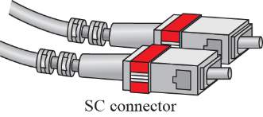
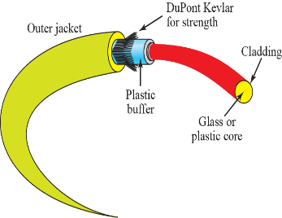
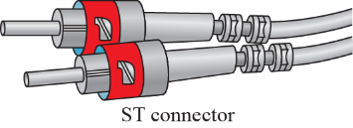
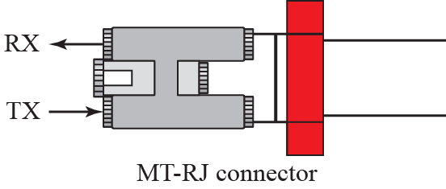
Fiber-Optic Cable
Figure 7.14: Fiber connection
Figure 7.15: Fiber-optic cable connector

Slide 14
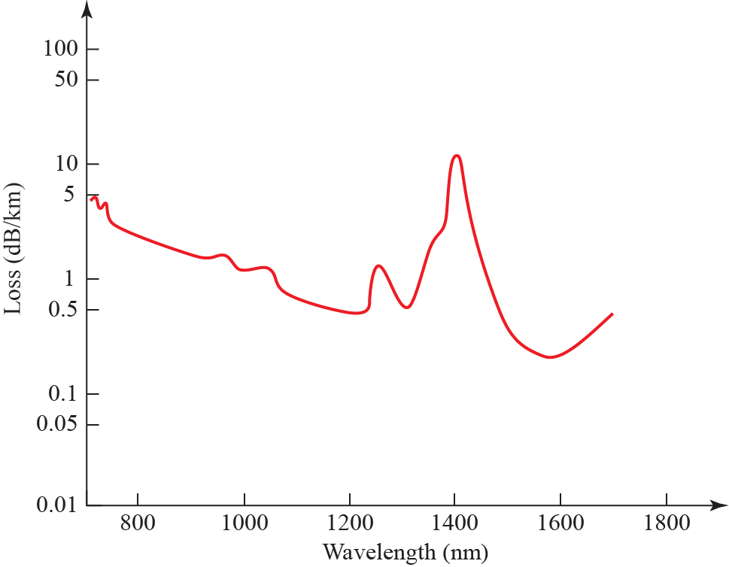
Fiber-Optic Cable
Figure 7.16: Optical fiber performance

Slide 15
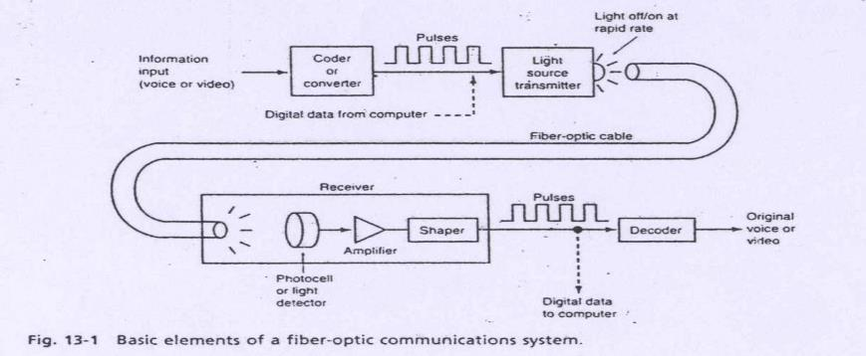
Optical Communication
The components of a typical fiber-optic com­munications system are illustrated in following Fig. 13-1. The information signal to be transmitted may be voice, video, or computer data. The first step is to convert the information into a form compatible with the communications medium. This is usually done by converting continuous analog signals such as voice and video (TV) signals into a series of digital pulses. An A/D converter is used for this purpose. Computer data is already in digital form. These digital pulses are then used to flash a powerful light source off and on very rapidly.

Slide 16
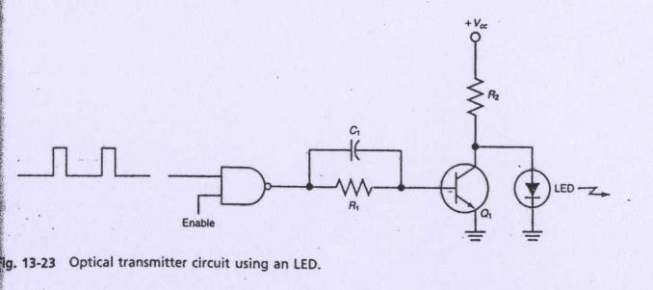
Fiber Optic Communication System
Light source: LED or ILD (Injection Laser Diode): amount of light emitted is proportional to the drive current
Source-to-fiber-coupler (similar to a lens):A mechanical interface to couple the light emitted by the source into the optical fiber
Light detector:PIN (p-type-intrinsic-n-type) or APD (avalanche photo diode) both convert light energy into current

Slide 17
Fiber Optic Communication System
The Digital data to be transmitted is converted into a serial pulse train and then into the desired RZ or NRZ format. These pulses are then applied to light transmitter.
The light transmitter consists of the LED and its associated driving circuitry.
A typical circuit is shown in Fig. 13-23. The binary pulses are applied to a logic gate which, in turn, operates a transistor switch Q₁ that turns the LED off and on.
A positive pulse at the NAND gate input causes the NAND output to go to zero. This turns off Q₁, so the LED is forward-biased through R₂ and turns on. With zero input, the NAND output is 1, so Q₁ turns on and shunts current away from the LED.

Slide 18
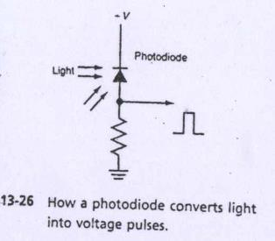
Fiber Optic Communication System
The receiver part of the optical communications system is relatively simple.
It consists of a detector that will sense the light pulses and convert them into an electrical signal.
This signal is then amplified and shaped into the original serial digital data. The most critical component, of course, is the light sensor.
The most widely used light sensor is a photodiode.
This is a silicon PN junction diode that is sensitive to light. This diode is normally reverse-biased as shown in Fig. 13-26

Slide 19
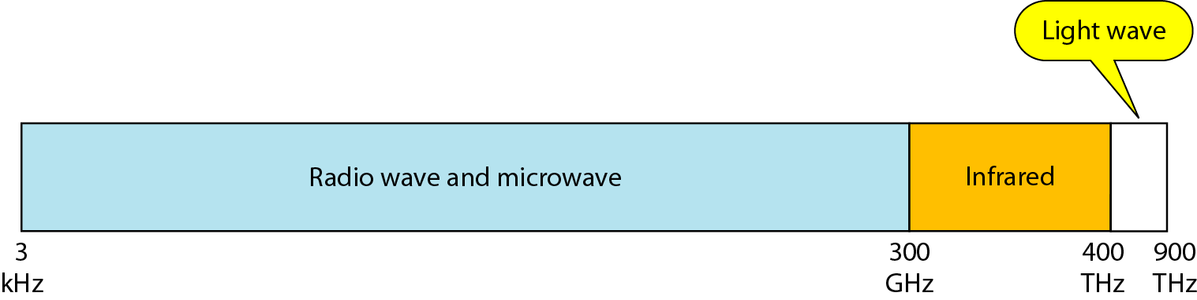
UNGUIDED MEDIA
Unguided medium transport waves without using a physical conductor. This type of communication is often referred to as wireless communication. Signals are normally broadcast through free space and thus are available to anyone who has a device capable of receiving them.
Figure 7.17: Electromagnetic spectrum for wireless communication

Slide 20
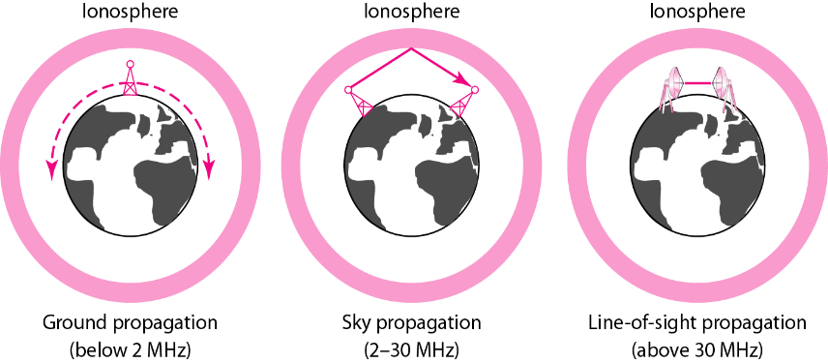
UNGUIDED MEDIA
Figure 7.18: Propagation methods

Slide 21
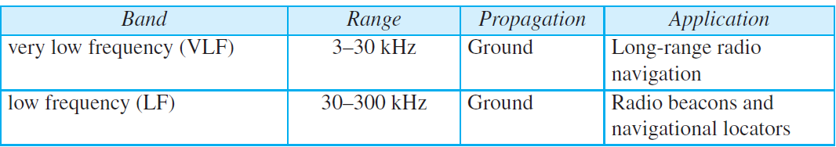
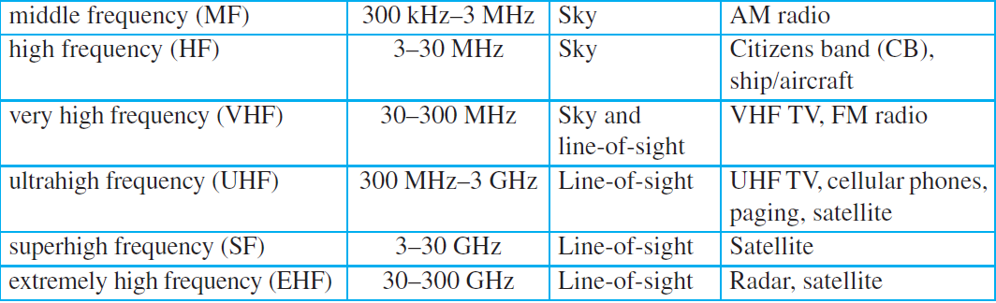
UNGUIDED MEDIA
Table 7.4: Bands

Slide 22
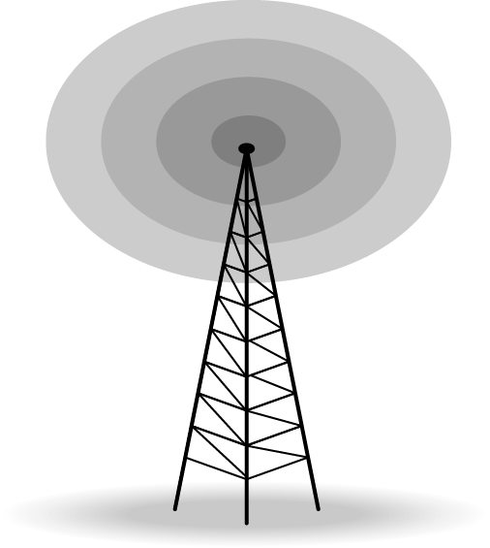
Radio Waves
Although there is no clear-cut demarcation between radio waves and microwaves, electromagnetic waves ranging in frequencies between 3 kHz and 1 GHz are normally called radio waves; waves ranging in frequencies between 1 and 300 GHz are called microwaves. However, the behavior of the waves, rather than the frequencies, is a better criterion for classification.
Figure 7.19: Omnidirectional antenna

Slide 23
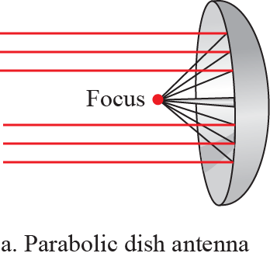
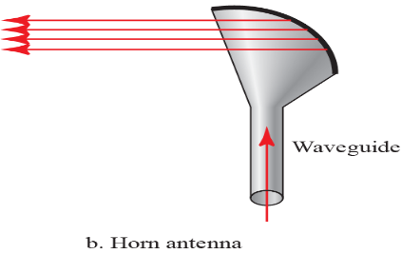
Microwaves
Electromagnetic waves having frequencies between 1 and 300 GHz are called microwaves. Microwaves are unidirectional. When an antenna transmits microwaves, they can be narrowly focused. This means that the sending and receiving antennas need to be aligned. The unidirectional property has an obvious advantage. A pair of antennas can be aligned without interfering with another pair of aligned antennas.
Figure 7.20: Unidirectional antenna

Slide 24
Infrared
Infrared waves, with frequencies from 300 GHz to 400 THz (wavelengths from 1 mm to 770 nm), can be used for short-range communication. Infrared waves, having high frequencies, cannot penetrate walls. This advantageous characteristic prevents interference between one system and another; a short-range communication system in one room cannot be affected by another system in the next room. When we use our infrared remote control, we do not interfere with the use of the remote by our neighbors.

Slide 25
Books
1. Forouzan, B. A. "Data Communication and Networking. Tata McGraw." (2005).

Slide 26
References
1. Prakash C. Gupta, “Data communications”, Prentice Hall India Pvt.
2. William Stallings, "Data and Computer Communications”, Pearson
3. Forouzan, B. A. "Data Communication and Networking. Tata McGraw." (2005).

